Slide 1

Simulating COVID-19 Spread Using a Markov Random Walk Model
Junyan He, Sam Aguiar, Albert Wiryawan
Team 1
Fall 2020
PHYS 466 Final Project Presentation
December 18, 2020

Slide 2

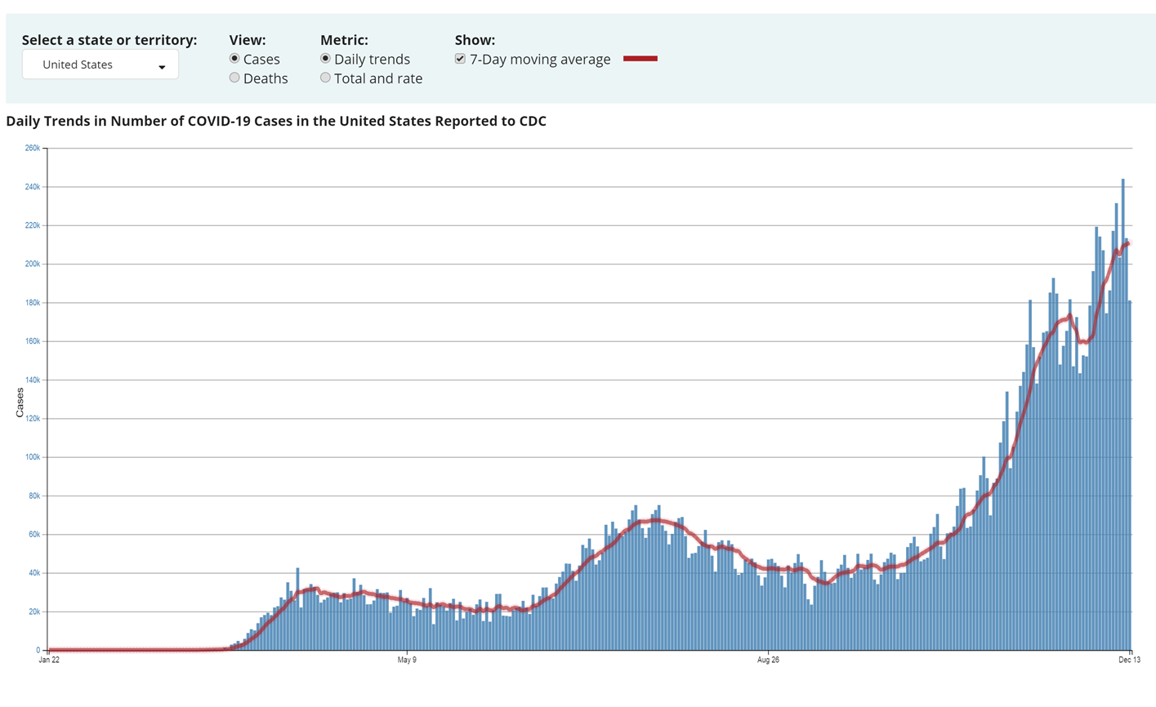
Background and Motivation
SARS-CoV-2, or Covid-19, has caused a global Pandemic since late 2019
Ever since the Pandemic started, numerous research efforts have been devoted to studying the transmission dynamics
Many models have been developed to study transmission dynamics:
Deterministic: Using ODEs, such as the SIR model
Probabilistic: Using Markov random walk model
Many government guidelines have been posted:
wearing mask, social distancing, and limiting large gathering
Some have questioned the effectiveness of such measures
In this study, we use a Markov random walk model to investigate the effects of the three measures mentioned above
Covid-19 is still spreading throughout the U.S.
Department of Mechanical Science and Engineering

Slide 3
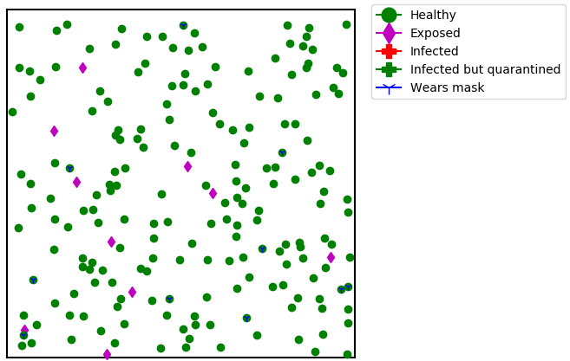
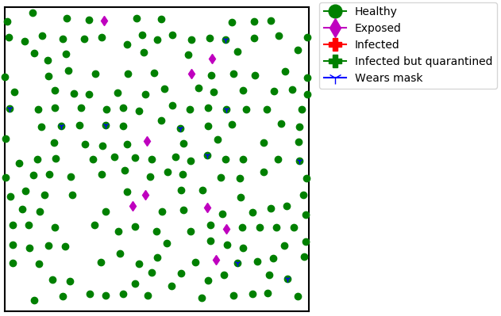
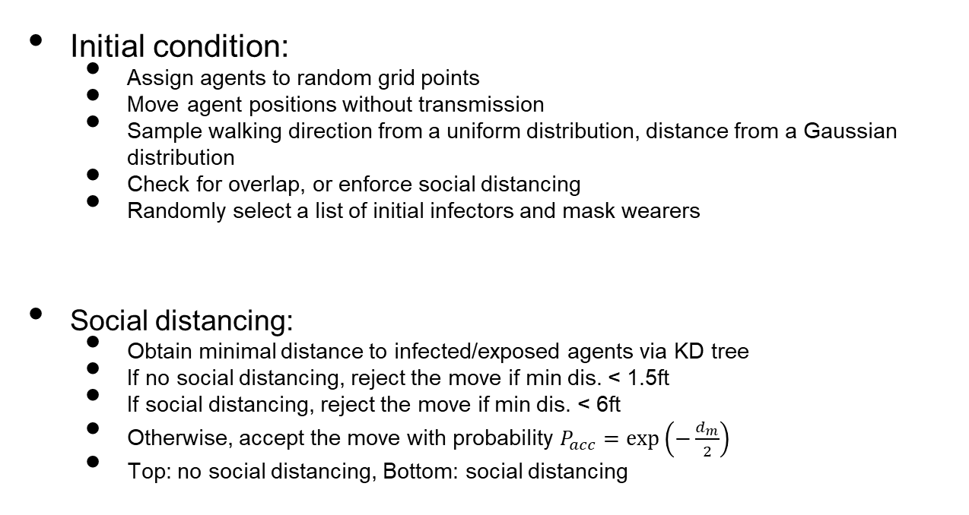
Method
Initial condition:
Assign agents to random grid points
Move agent positions without transmission
Sample walking direction from a uniform distribution, distance from a Gaussian distribution
Check for overlap, or enforce social distancing
Randomly select a list of initial infectors and mask wearers
Social distancing:
Obtain minimal distance to infected/exposed agents via KD tree
If no social distancing, reject the move if min dis. < 1.5ft
If social distancing, reject the move if min dis. < 6ft
Otherwise, accept the move with probability $P_{acc}=\exp\left(−\frac{d_{m}}{2}\right)$
Top: no social distancing, Bottom: social distancing
Department of Mechanical Science and Engineering

Slide 4
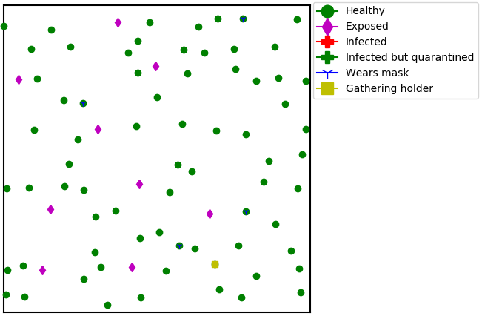
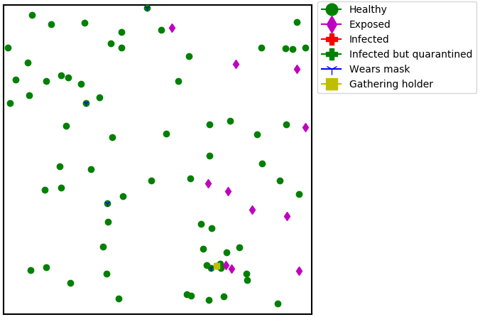
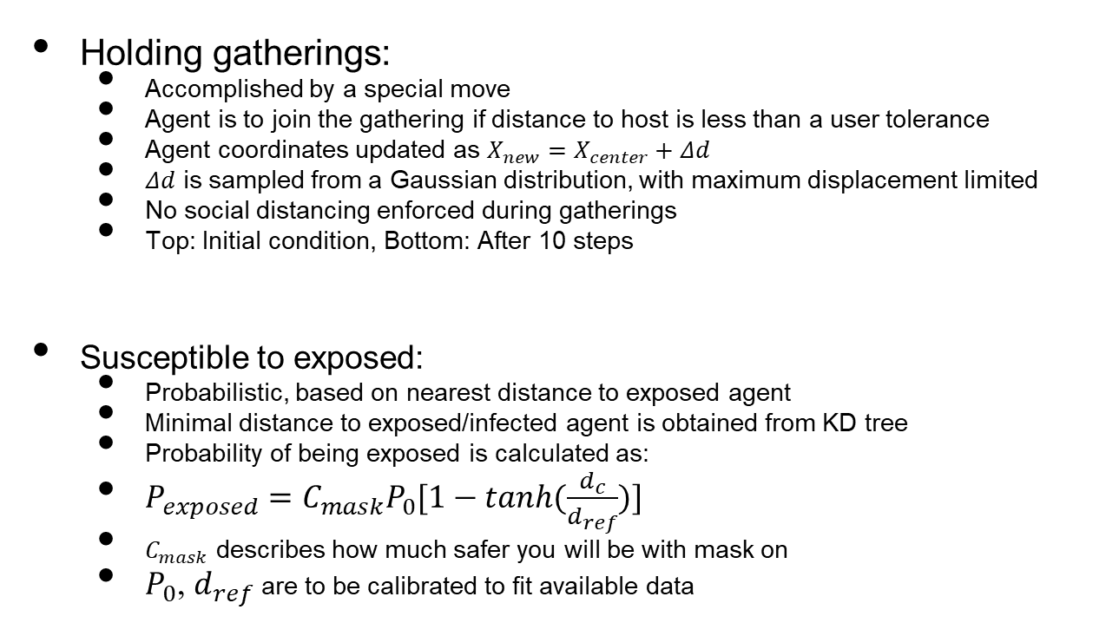
Method
Holding gatherings:
Accomplished by a special move
Agent is to join the gathering if distance to host is less than a user tolerance
Agent coordinates updated as $X_{new}=X_{center}+Δd$
$Δd$ is sampled from a Gaussian distribution, with maximum displacement limited
No social distancing enforced during gatherings
Top: Initial condition, Bottom: After 10 steps
Susceptible to exposed:
Probabilistic, based on nearest distance to exposed agent
Minimal distance to exposed/infected agent is obtained from KD tree
Probability of being exposed is calculated as:
$P_{exposed}=C_{mask}P_{0}[1−tanh(\frac{d_{c}}{d_{ref}})]$
$C_{mask}$ describes how much safer you will be with mask on
$P_{0}$, $d_{ref}$ are to be calibrated to fit available data
Department of Mechanical Science and Engineering

Slide 5
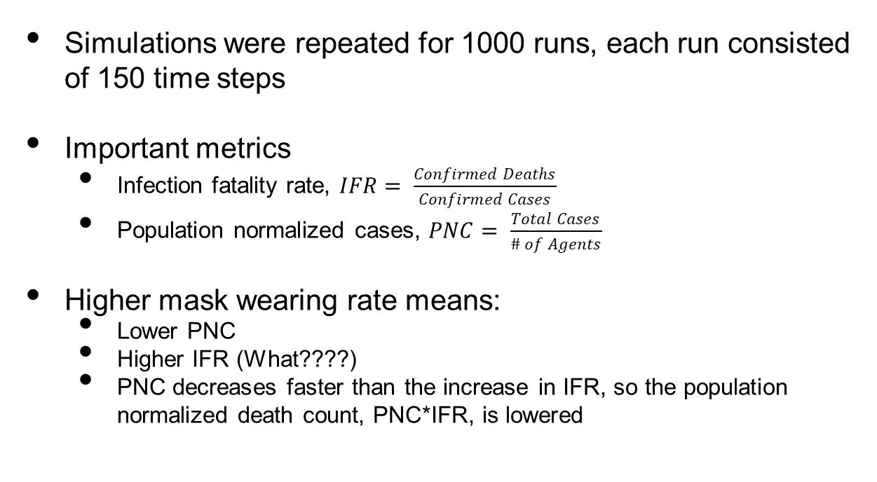
Results: Mask wearing percentage
Simulations were repeated for 1000 runs, each run consisted of 150 time steps
Important metrics
Infection fatality rate, $IFR= \frac{Confirmed Deaths}{Confirmed Cases}$
Population normalized cases, $PNC= \frac{Total Cases}{\# of Agents}$
Higher mask wearing rate means:
Lower PNC
Higher IFR (What????)
PNC decreases faster than the increase in IFR, so the population normalized death count, PNC*IFR, is lowered
Department of Mechanical Science and Engineering

Slide 6
Results: Mask wearing percentage
Higher mask wearing rate means:
More agents remain healthy at steady state
Fewer exposed cases at peak
Lower quarantine and death rate
All these metrics indicate that wearing masks is an effective way to slow down virus transmission
Department of Mechanical Science and Engineering

Slide 7
Results: Social distancing
Table 1. Effect of Extreme Social Distancing on IFR and PNC
Social Distancing | IFR (%) | IFR SD | PNC (%) | PNC SD
FALSE | 1.02 | 3.54 | 6.25 | 3.78
TRUE | ~0* | ~0* | 0.39 | 0.55
*Values were less than 10⁻²%
Simulations were repeated for 3000 runs, each run consisted of 150 time steps
Social distancing means:
Lower IFR (fewer deaths)
Much lower PNC (fewer cases)
Department of Mechanical Science and Engineering

Slide 8
Results: Social distancing
Social distancing means:
Much, much more agents remain healthy at steady state
Fewer exposed cases at peak
The infected curve is efficiently flattened
Lower quarantine and death rate
Social distancing works as an effective measure to slow down the spread and flatten the curve!
Department of Mechanical Science and Engineering

Slide 9
Results: Large social gatherings
Table 2. Effect of Gatherings on IFR and PNC
Gatherings | IFR (%) | IFR SD | PNC (%) | PNC SD
FALSE | 1.44 | 5.72 | 6.39 | 4.28
TRUE | 0.36 | 1.1 | 39.8 | 22.85
Simulations were repeated for 3000 runs, each run consisted of 250 time steps
One gathering was introduced
Having large gatherings means:
Lower IFR (Good thing??)
Much higher PNC
Overall, leads to more deaths
Department of Mechanical Science and Engineering

Slide 10
Results: Large social gatherings
Having large gatherings means:
Much, much more agents fall sick
First peak of exposed cases is similar, but having gathering leads to a second peak
The infected curve fails to decrease after initial peak
Quarantine nearly triples
Almost double the death rate
Having large gatherings without obeying social distancing rules can very likely lead to super-spreader events!
Department of Mechanical Science and Engineering

Slide 11
Conclusion
Implemented a Markov random walk model to simulate transmission dynamics of Covid-19
Social distancing introduced through a distance-based rejection technique, large gatherings emulated through a special move function
Probability of getting exposed is distance-based, with distance calculated by a KD tree
Mask wearing slow downs the transmission, leads to more healthy agents and fewer deaths
Social distancing is effective in flattening the curve, and lowering the death rate
Having large gatherings without social distancing leads to more cases and possible even a second peak in exposed cases
Department of Mechanical Science and Engineering

Slide 12

Thank you!
Questions?

